Slide 1
Twitter & share prices
Impact of CEO Tweets on stock prices using Sentiment Analysis
Amalia Temneanu, Dae-Jin Rhee, Marcela Ulloa, Nicolas Bidaux

Slide 2
Is there a basis for the so-called “Elon Effect”?
Social media could be construed as a proxy for public sentiment and opinion about current events. Some studies have shown that the aggregate public mood collected from Twitter could be correlated with Dow Jones Industrial Average Index (DJIA). We will analyse if tweets of company CEO’s are correlated with changes in stock prices.

Slide 3
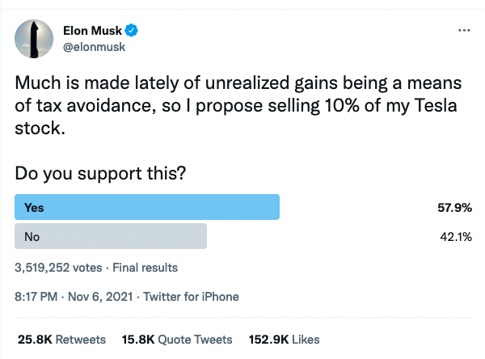
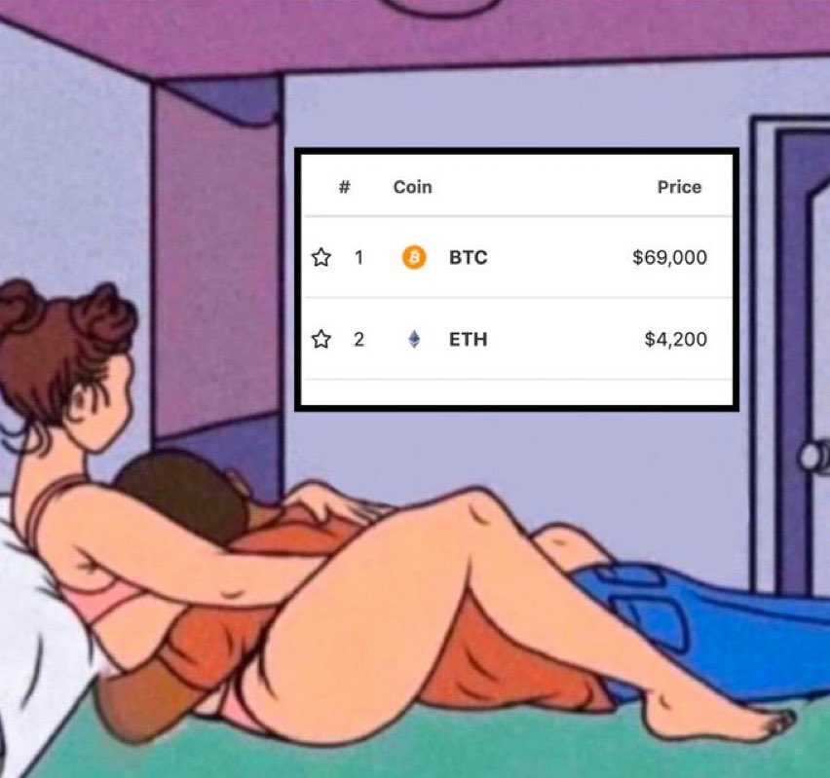
TSLA -5%
TSLA +5%

Slide 4
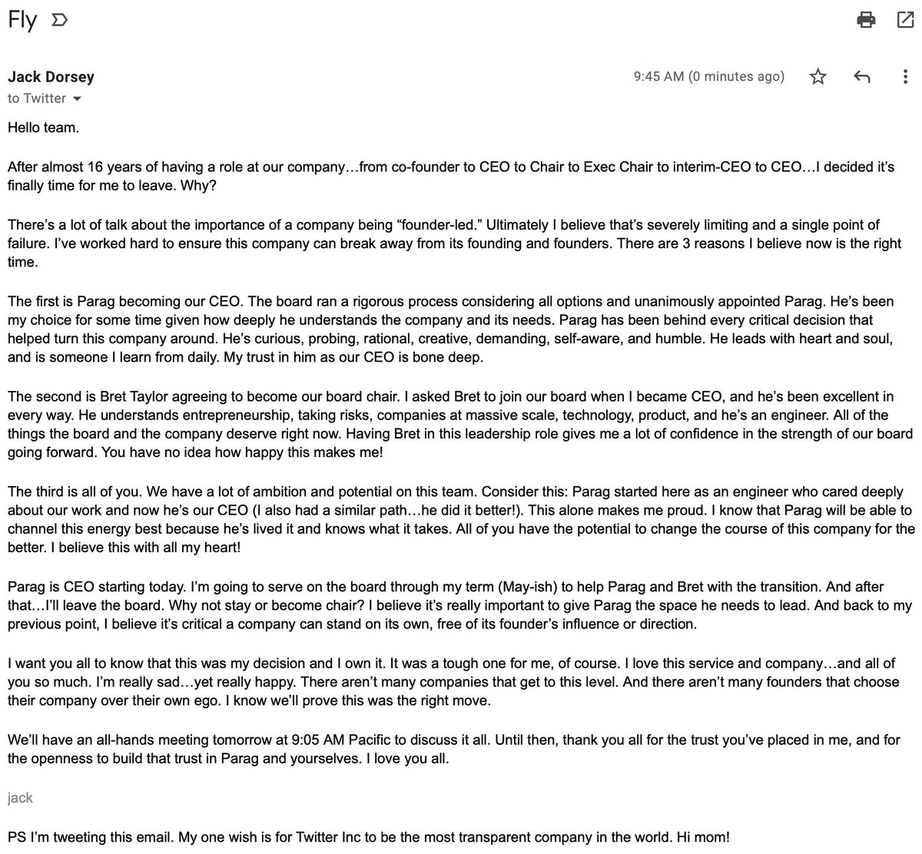
TWTR -4%

Slide 5
Methodology Used

Slide 6
Twitter and impact on share prices
Approach & methodology
Twitter API: Fetching Tweets of company CEOs
Stock prices of publicly listed companies (yahoo finance)
Data cleaning
TextBlob or VADER for Sentiment Analysis
WordCloud
Regression analysis
Conclusions

Slide 7
Our process
Getting the Data
Cleaning the Data
Applying Sentiment Analysis
Using Word Clouds
Statistical Analysis
Using the Twitter API to download tweets of company CEOs
Downloading CSV files of stock prices on Yahoo Finance
Using Pandas to import all data as DataFrames
Using basic functions to clean up tweets
Merging DataFrames
Applied TextBlob on Tweet DataFrames
Getting an extra column with a “sentiment score”
Obtained WordClouds for each CEO
T-test
Correlation matrix: using Pearson correlation coefficient and Spearman correlation coefficient
Simple Linear Regression model
Multiple linear regression model

Slide 8
CEOs Twitter Activity

Slide 9
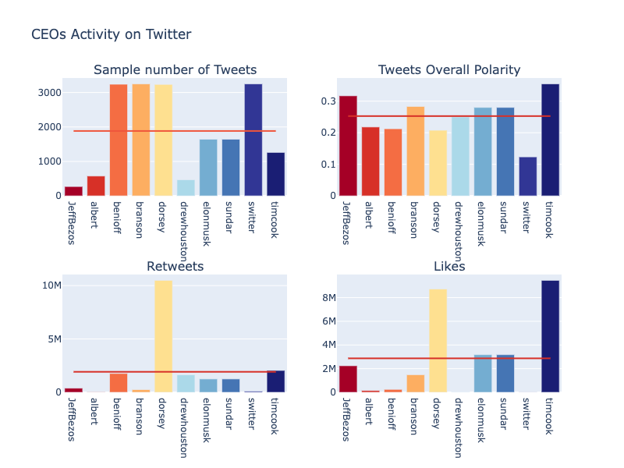
Notes:
'Sundar Pachai', 'Albert Bourla', 'Marc Benioff', 'Richard Branson','Jack Dorsey','Drew Houston','Elon Musk','Jeff Bezos','Tim Cook','Switter'

Slide 10
WordClouds

Slide 11
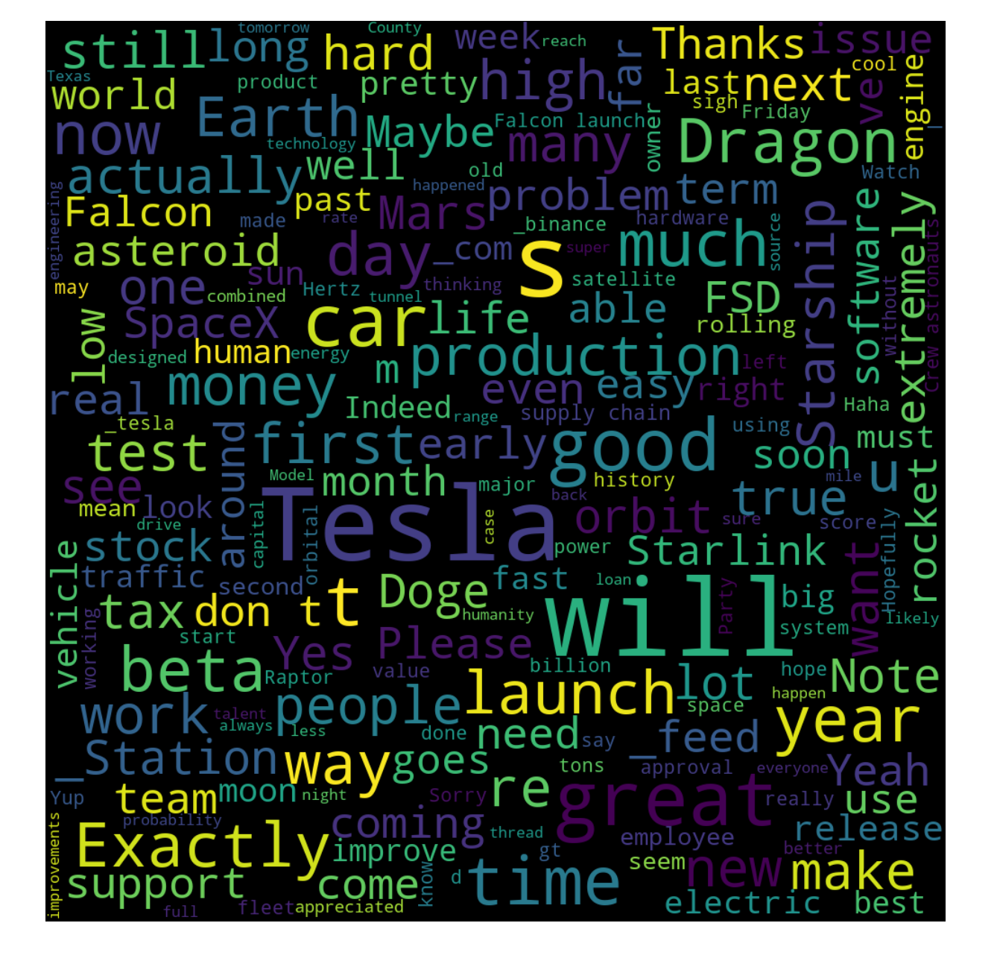
Elon Musk - Tesla

Slide 12
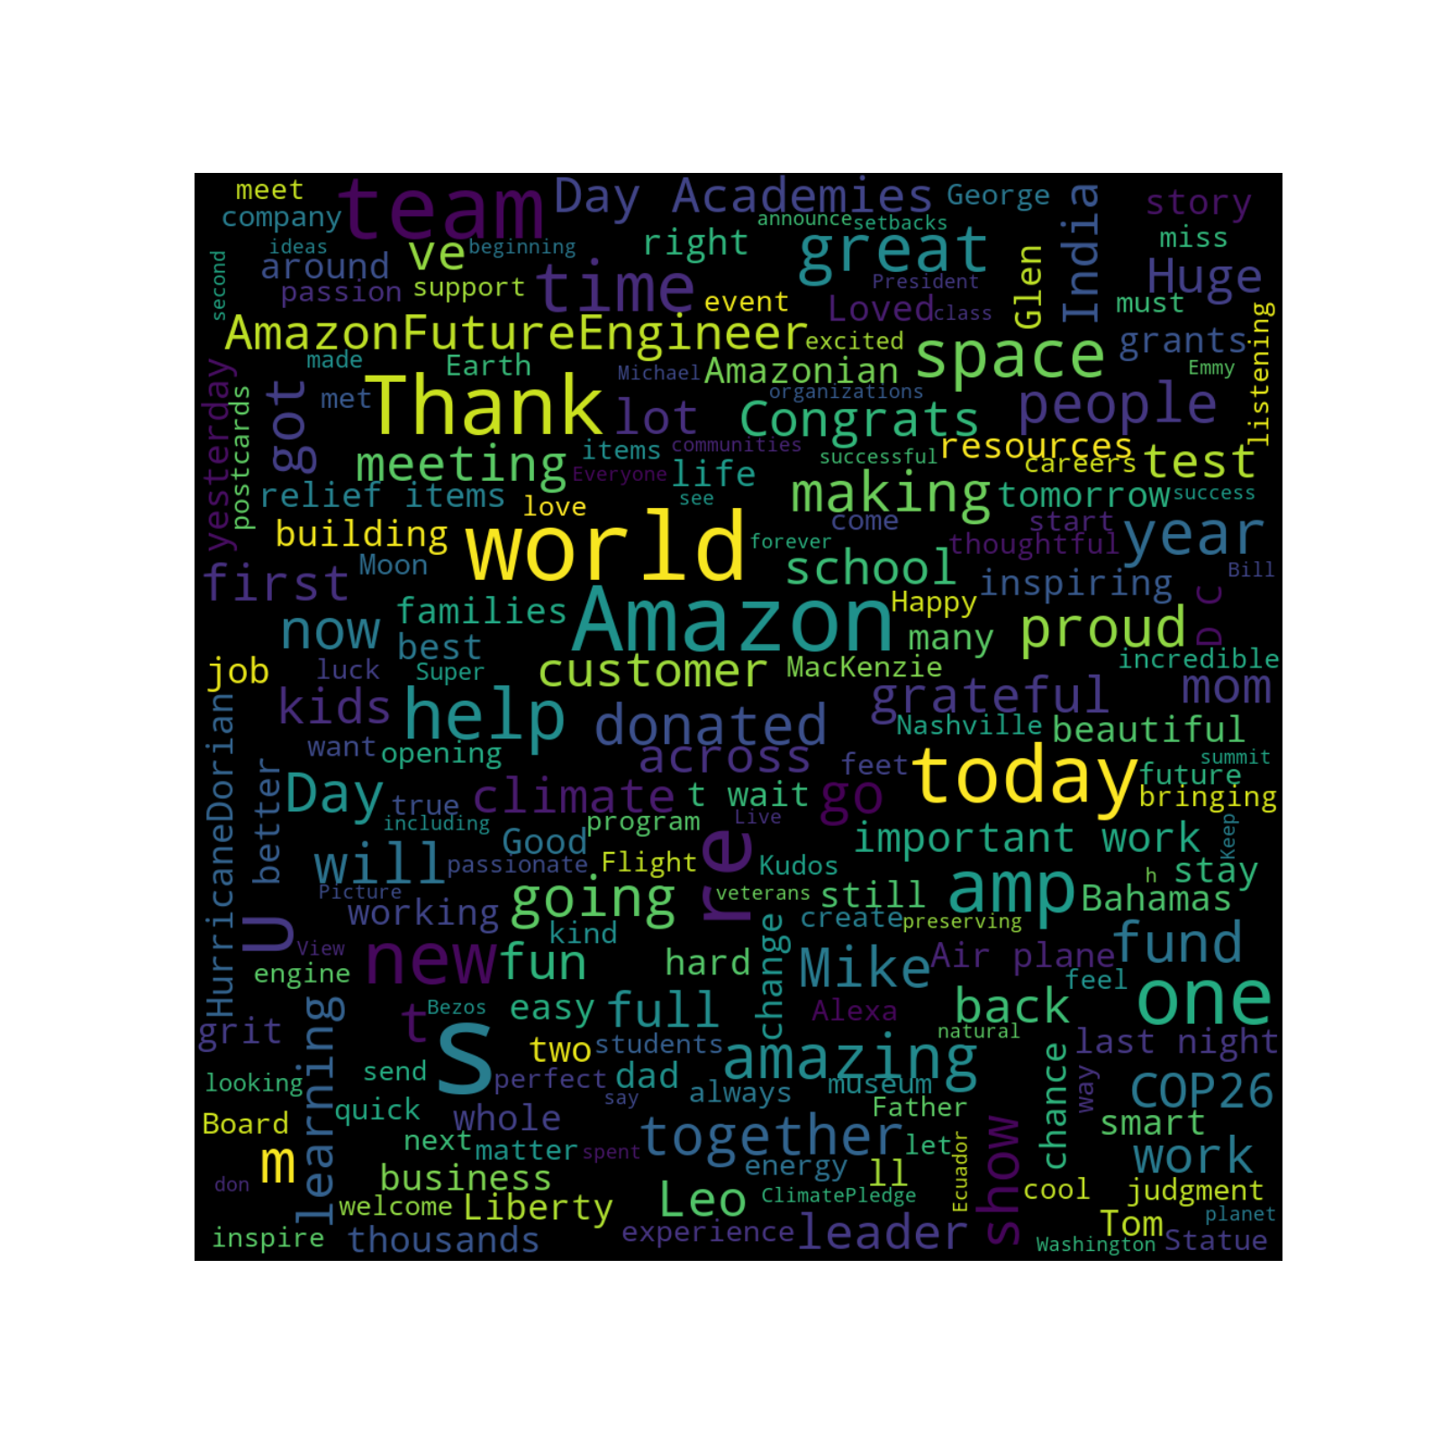
Jeff Bezos - Amazon

Slide 13
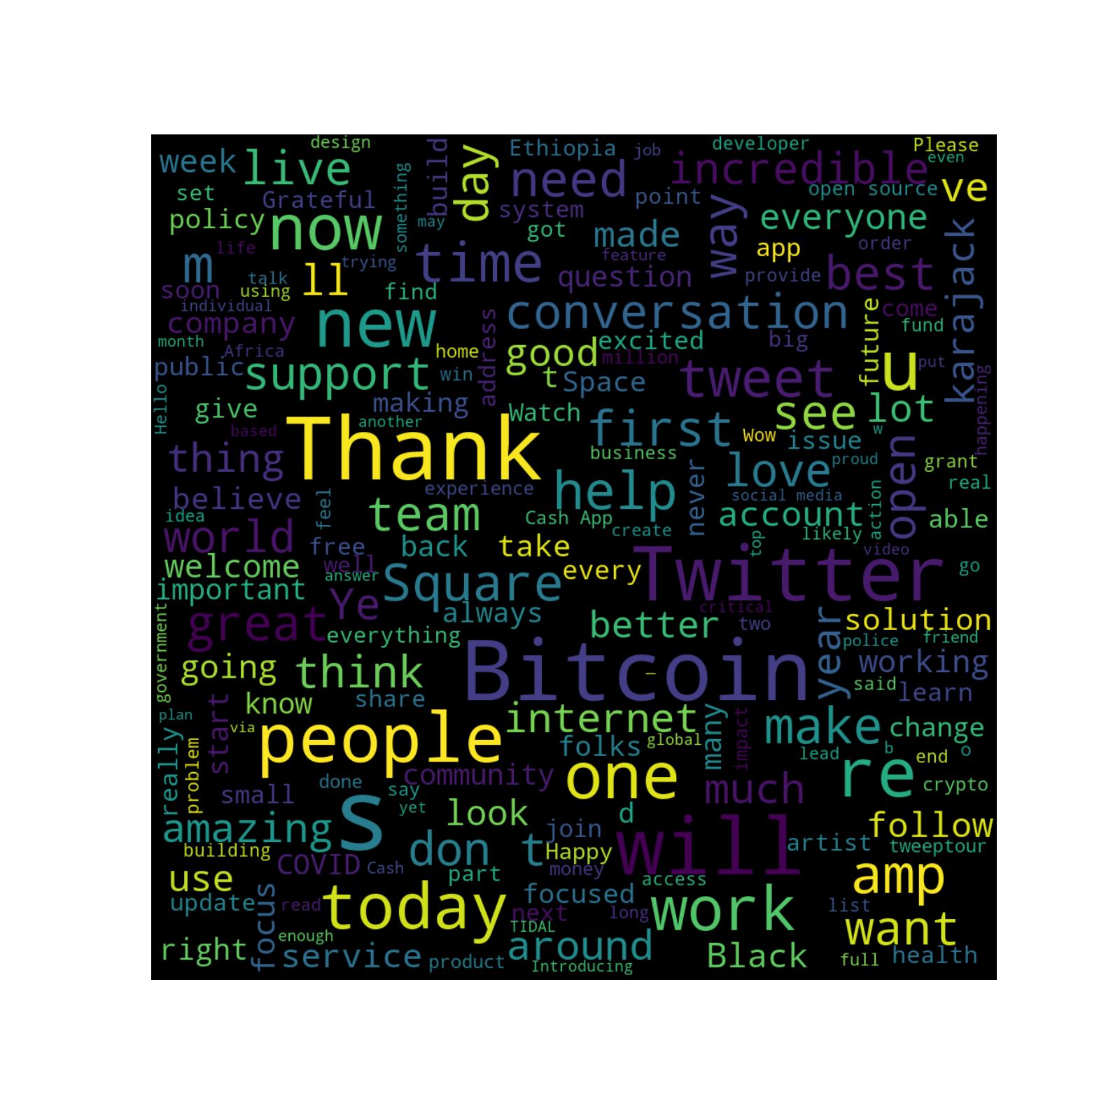
Jack Dorsey - Twitter

Slide 14

Tim Cook - Apple

Slide 15
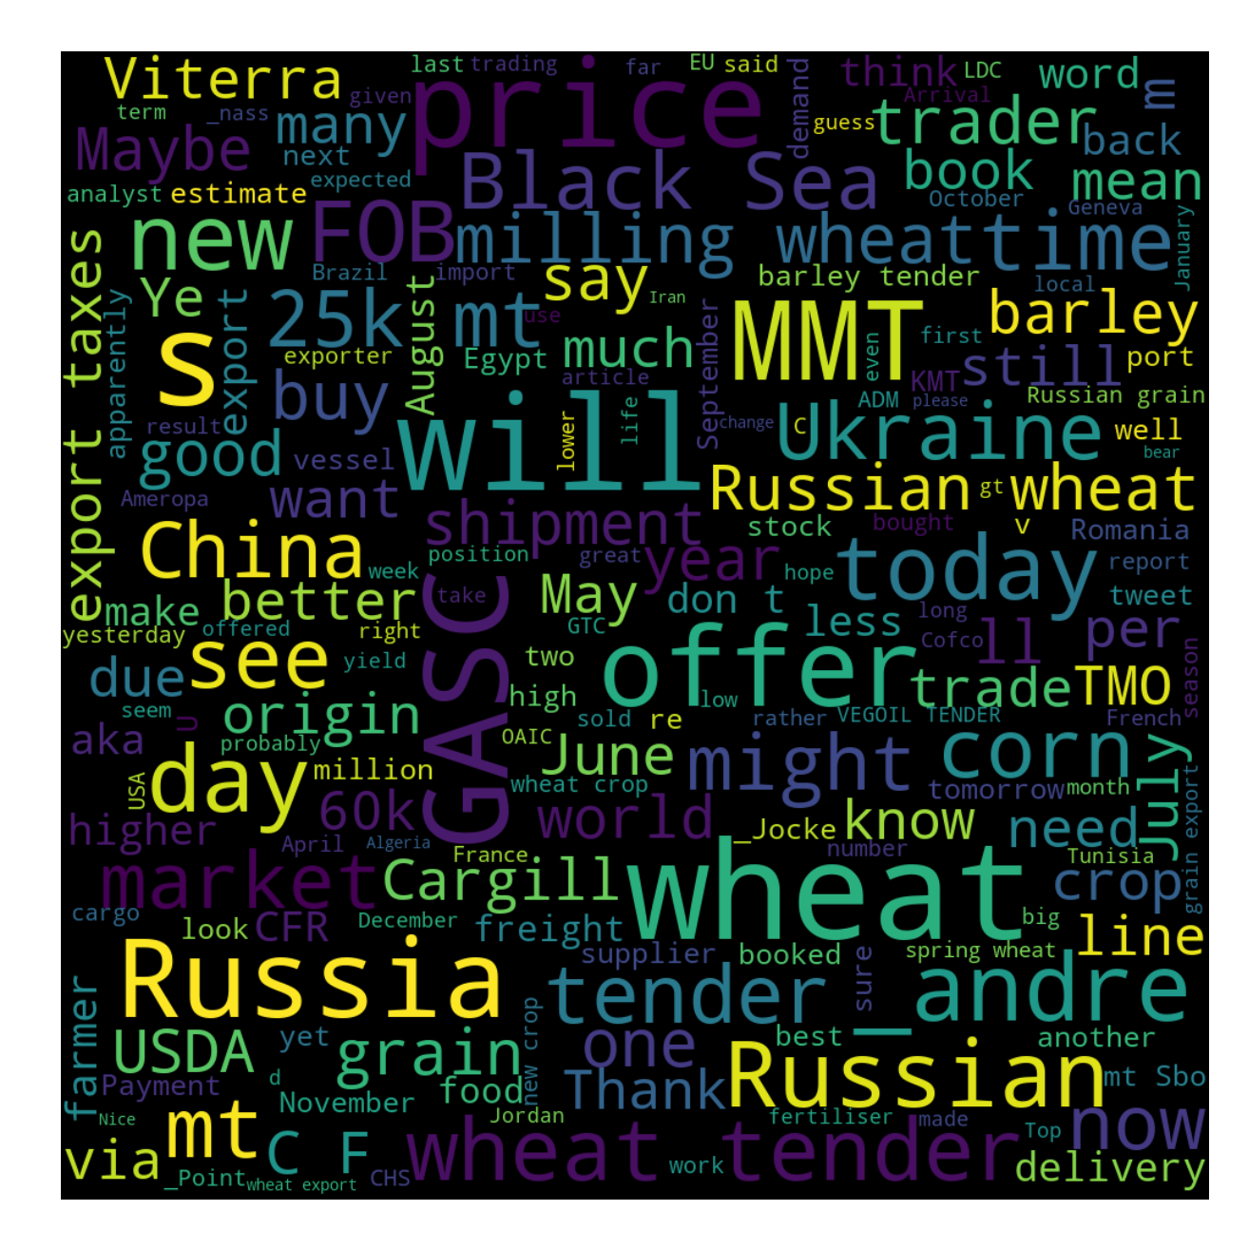
Russian Trader - Wheat

Slide 16
Data Analysis

Slide 17
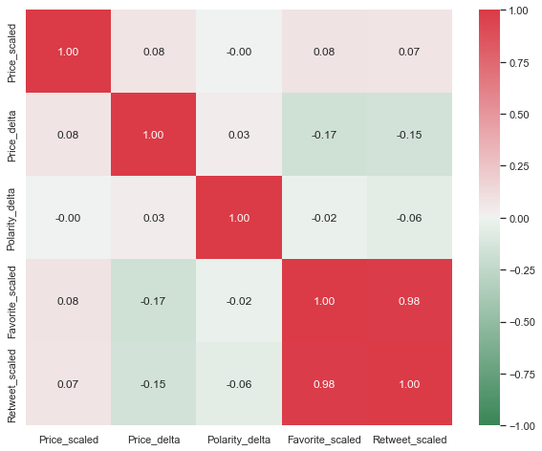
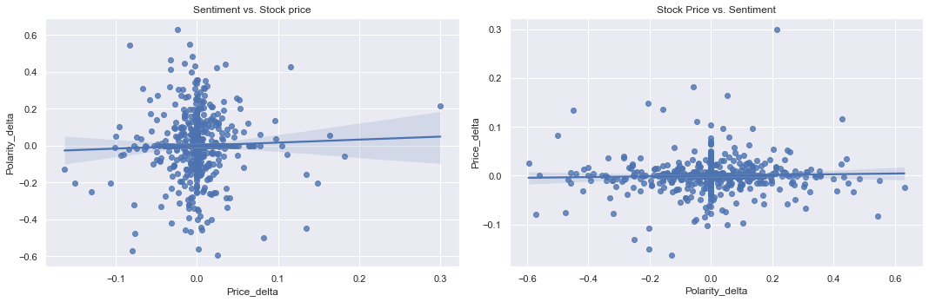
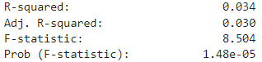
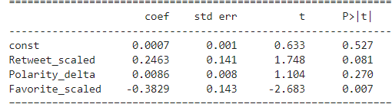
Richard Branson tweets - Virgin Galactic stock price
H0: the changes in stock market prices are similar on average compared to the changes in CEO's Twitter sentiment
T-test: the p-value was larger than the significance level of 5%
Correlation matrix: using Pearson correlation coefficient and Spearman correlation coefficient - no correlation
Simple Linear Regression model: no significant coefficients (based on their p-values) and R squared approximately equal to zero
Multiple linear regression model: F-test of overall significance, concludes that our model is better compared to a model with no independent variables, the t-test for each coefficient returns only one significant coefficient, the number of likes per tweet; low coefficient of determination
Sentiment vs. Stock price
Notes:
T-test: the p-value was larger than the significance level of 5%, therefore we could not reject the null hypothesis of equal population means
Simple Linear Regression model: no significant coefficients (based on their p-values) and R squared approximately equal to zero, therefore we could not fit a regression line to estimate the relationship between the stock prices and sentiment change or number of likes.
Correlation matrix: using Pearson correlation coefficient and Spearman correlation coefficient - no correlation - the strength and direction of a linear relationship between the variables is ZERO
Multiple linear regression model: F-test of overall significance, which assesses all of the coefficients jointly, concludes that our model is better compared to a model with no independent variables, but the t-test for each coefficient returns only one significant coefficient, the number of likes per tweet. The coefficient of determination, which measures the proportion of the variation in the dependent variable that is predictable from the independent variables is low - approx. zero.

Slide 18
No correlation found when analysing CEO’s Twitter accounts and their companies’ stock prices evolution…
So who does influence the markets?

Slide 19
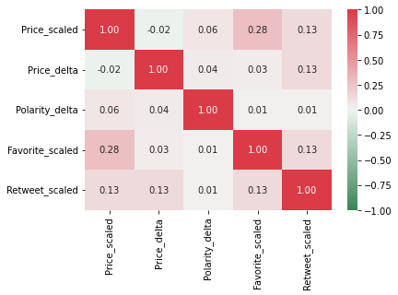
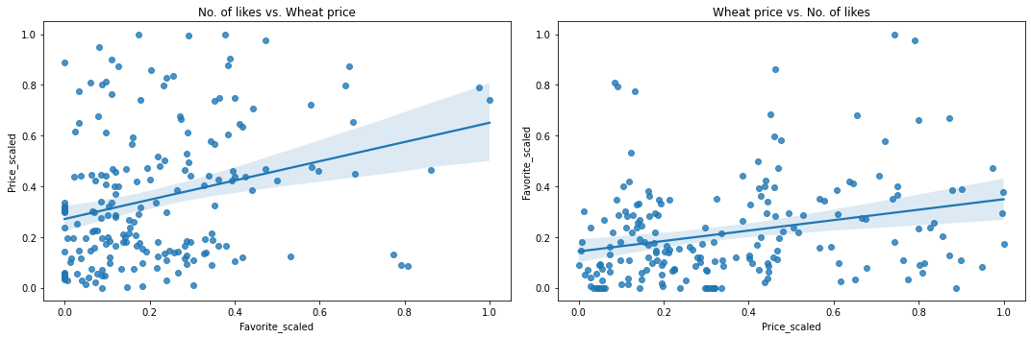
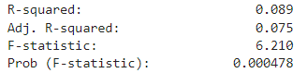
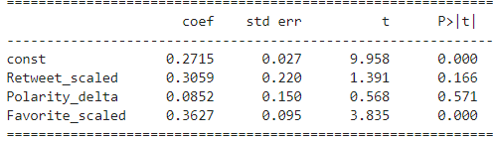
𝑺𝒘𝒊𝒕𝒕𝒆𝒓 ™ tweets - MATIF Milling Wheat price
H0: the changes in wheat prices are similar on average compared to the changes in the commodities trader influencer’s Twitter sentiment
T-test: the p-value was larger than the significance level of 5%
Correlation matrix: there is a positive correlation between the number of likes per Tweet and the price of wheat - the strength of a linear relationship between those two variables is 0.28
Simple Linear Regression model: dependent variable: price of wheat, independent variable: no. of likes per tweet, significant coefficient based on its p-value, R squared approximately equal to 0.078, Adj. R-squared 0.073
Multiple linear regression model: t-test for each coefficient returns only one significant coefficient - the number of likes per tweet, the coefficient of determination, which measures the proportion of the variation in the dependent variable that is predictable from the independent variables is 0.089
No. of likes vs. Wheat price
Notes:
T-test: the p-value was larger than the significance level of 5%, therefore we could not reject the null hypothesis of equal population means
Correlation matrix: using Pearson correlation coefficient and Spearman correlation coefficient (based on ranks) - there is a positive correlation between the number of likes per Tweet and the price of wheat - the strength and direction of a linear relationship between those two variables is 0.28
Simple Linear Regression model: dependent variable: price of wheat, independent variable: no. of likes per tweet, significant coefficient based on its p-value, R squared approximately equal to 0.078, Adj. R-squared 0.073, F-test of overall significance concludes that our model is better compared to a model with no independent variables
Multiple linear regression model: F-test of overall significance concludes that our model is better compared to a model with no independent variables, but the t-test for each coefficient returns only one significant coefficient, the number of likes per tweet. The coefficient of determination, which measures the proportion of the variation in the dependent variable that is predictable from the independent variables is 0.089.

Slide 20
Conclusions

Slide 21
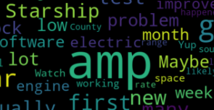
Issues encountered
Random amount of tweets from Elon Musk’s Twitter account
Limited sample size (last ~3200 Tweets per account)
(biased samples)
Recurring &amp in Workcloud
Heterogeneous mix of personal and professional tweets

Slide 22
5. Conclusions
Conclusion
Tweets of CEO’s have no correlation to their respective companies’ stock prices
For tweets which impact markets look for Twitter influencers in different sectors (commodities, real-estate, etc.)

Slide 23
Thank you for your attention

